Slide 1
Logistic Regression Regression Tree

Slide 2
Logistic Regression:
Logistic regression models a relationship between a categorical response variable and predictor variables.
It predicts the probability of a certain event occurring.
It uses the logistic function (sigmoid function, which has S-shaped curve), to model the relationship.
Logistic regression is a nonlinear model.

Slide 3
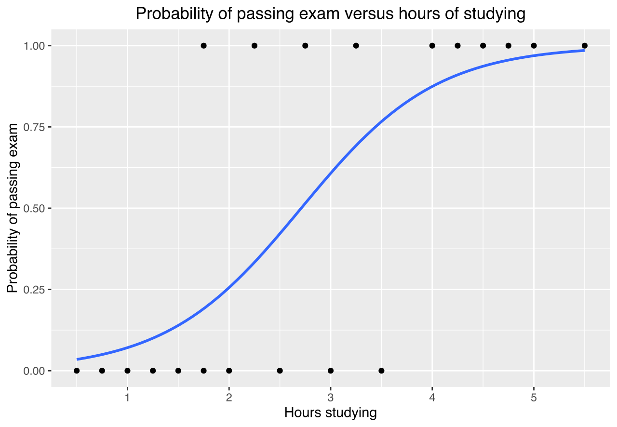
Figure 1 An example of sigmoid (S) function

Slide 4
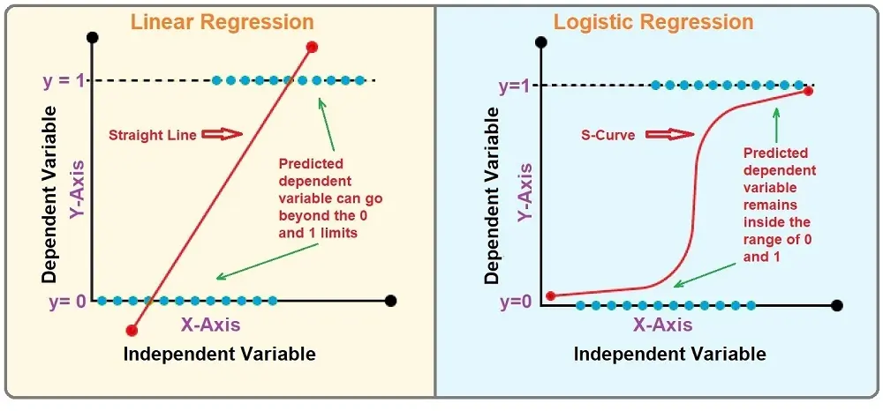
Figure 2 Linear regression vs. logistic regression
The output of logistic regression is bounded between 0 and 1.
The output of linear regression is unbounded.

Slide 5
Types of Logistic Regression:
Binary Logistic Regression: It is the most common type of logistic regression and is used when the response is binary (two possible outcomes).
Multinomial (Multiclass) Logistic Regression: It is an extension of binary logistic regression to model a response with three or more categories.
Ordinal Logistic Regression: It is sed when there are three or more categories with a natural order.

Slide 6
Logistic Regression Usage:
Logistic regression can be used for both predictive modeling and classification tasks.
Prediction: It can precited the probability of an event occurring based on given predictor variable(s).
Classification: It assigns an input to a specific class or category based on the predicted probability.

Slide 7
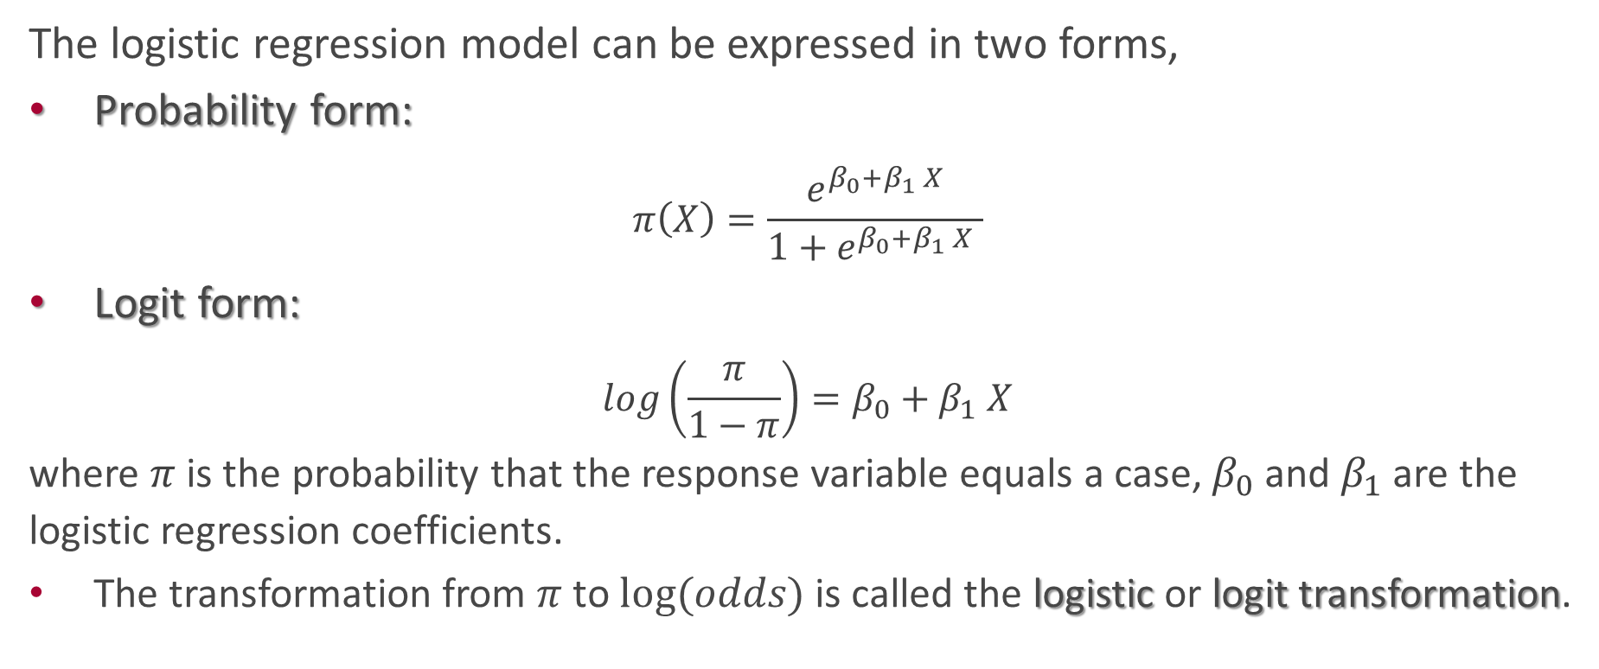
Logistic Regression Forms:
The logistic regression model can be expressed in two forms,
Probability form:
$$π\left(X\right)=\frac{e^{β_{0}+β_{1} X}}{1+e^{β_{0}+β_{1} X }}$$
Logit form:
$$log\left(\frac{π}{1−π}\right)=β_{0}+β_{1} X$$
where $π$ is the probability that the response variable equals a case, $β_{0}$ and $β_{1}$ are the logistic regression coefficients.
The transformation from $π$ to $log⁡(odds)$ is called the logistic or logit transformation.

Slide 8
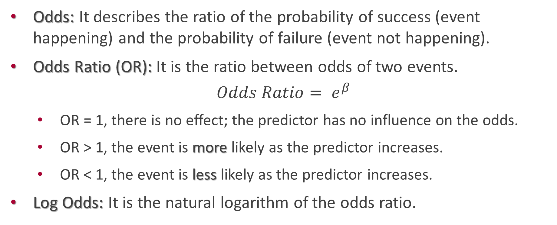
Odds, Odds Ratio, and Log Odds:
Odds: It describes the ratio of the probability of success (event happening) and the probability of failure (event not happening).
Odds Ratio (OR): It is the ratio between odds of two events.
$$Odds Ratio= e^{β}$$
OR = 1, there is no effect; the predictor has no influence on the odds.
OR > 1, the event is more likely as the predictor increases.
OR < 1, the event is less likely as the predictor increases.
Log Odds: It is the natural logarithm of the odds ratio.

Slide 9
Confusion Matrix:
A confusion matrix is a table that is used to visualizes and summarizes the performance of a classification algorithm.

Slide 10
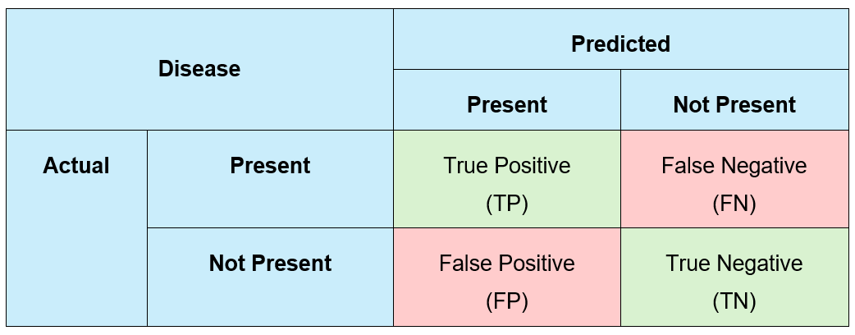
Table 1 Confusion Matrix
True Positive: The number of instances correctly predicted as the positive class.
False Positive: The number of instances incorrectly predicted as the positive class (Type I error).
False Negative: The number of instances incorrectly predicted as the negative class (Type II error).
True Negative: The number of instances correctly predicted as the negative class.

Slide 11
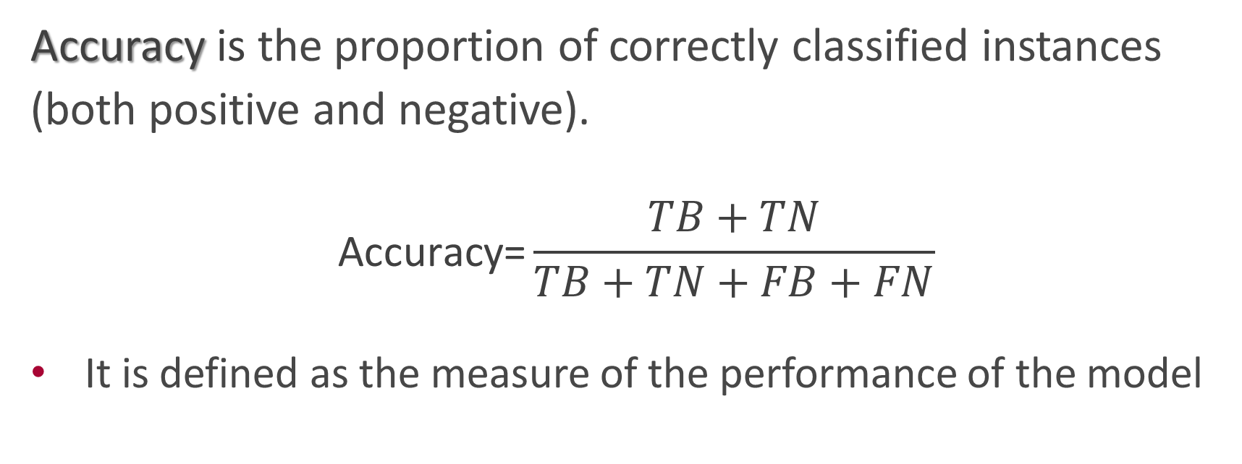
Accuracy:
Accuracy is the proportion of correctly classified instances (both positive and negative).
$$\text{Accuracy}\text{=}\frac{TB+TN}{TB+TN+FB+FN}$$
It is defined as the measure of the performance of the model

